Slide 1

PREDICTING ARRIVAL TIMES
The development and implementation of Wheels Down
May 2022
Notes:
Our team, Flight Predictors uses a three-phase approach in the implementation of Wheels Down at each airport. Phase one is feature engineering and data mining based on data retrieved from airport air navigation services and air traffic control. Phase two is training and testing Wheels Down, an ensemble decision tree algorithm to predict exactly how long it will take for the plane to touchdown from 120 NM away from the runway. Phase three is development of a summary dashboard with key findings to stakeholders, as well as a real time dashboard showing flight traffic in airport airspace and minutes to landing. The dashboard will be made available to all pertinent airport personnel as part of a collaborative decision-making tool and/or incorporated into existing real time dashboard reporting.
Our goal was to create a prototype for a scalable product that can improve airport throughput operations at airports across the world. Our prototype was designed and tested on DXB.

Slide 2

Introduction

Slide 3
Background & Business Understanding

Slide 4
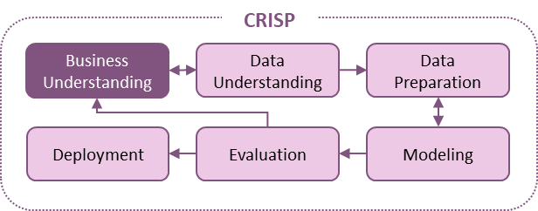


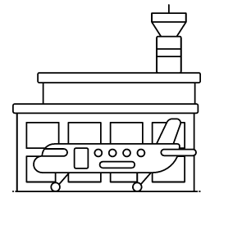



Background

Slide 5







Arrival Operations
Aircraft Navigation
Aircraft Cleaning
Baggage Handling
Aircraft Maintenance
Facility Management
Catering

Slide 6
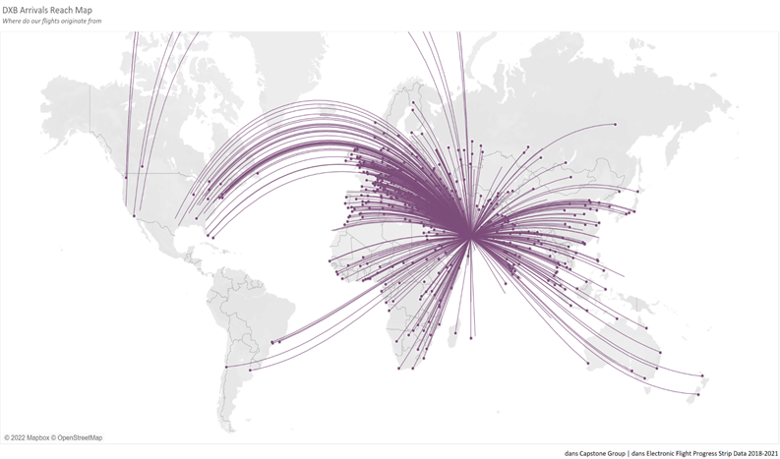
DXB
80 Airlines
90,000,000 Passengers
200 Destinations
400,000 Jobs

Slide 7
Business Problem
Arrival crews do not have enough advanced notice of arriving aircraft
The only way to increase throughput is by increasing capacity on the existing runways
The two runways are unable to operate independently from each other due to physical proximity
Due to geographic constraints, there is no possibility of real estate expansion or adding more runways

Slide 8
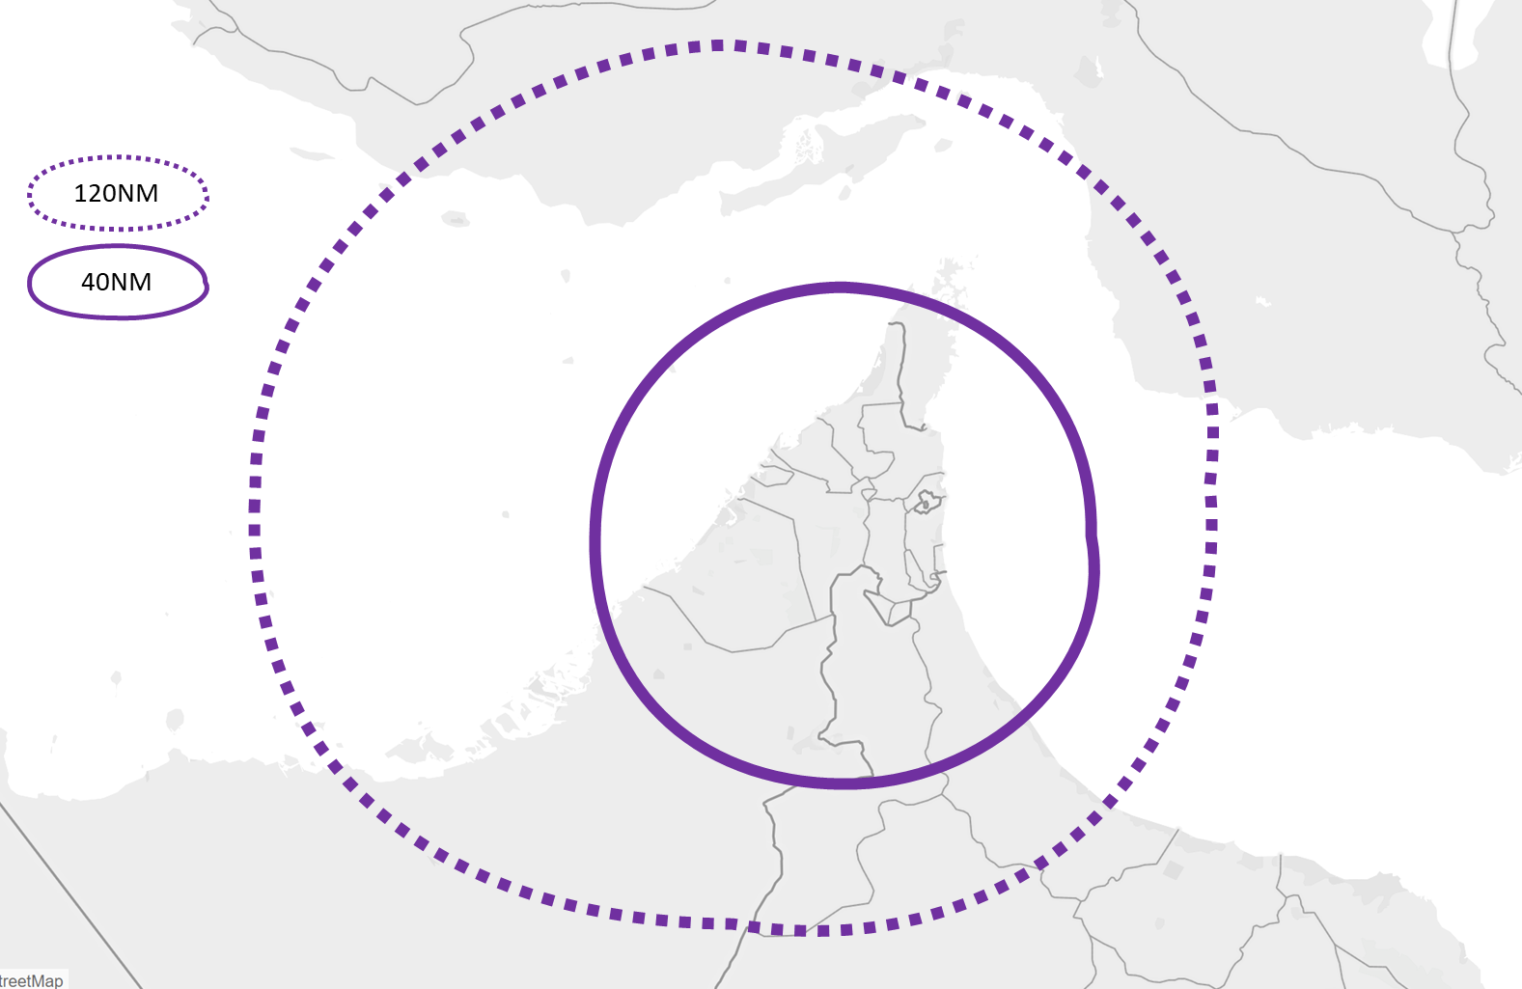
Objective
Develop a model that accurately predicts arrival time 120 NM from the runway (apx 30 minutes from runway)
Current estimates of aircraft arrival times:
40NM away (approximately 15 minutes) from the runway
Accurate (within 3 minutes) 34% of the time.
40 Mins
15 Mins

Slide 9




Project Goals
Ground Crew Resource Management
Airspace Management
Throughput Capacity
Passenger Journey

Slide 10
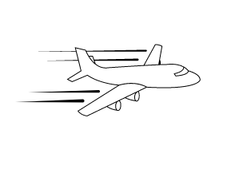

Scope
Prediction Point
Accurate within 3 minutes of actual landing time for at least 70% of flights
Minutes to Fly
Wheels down on runway

Slide 11
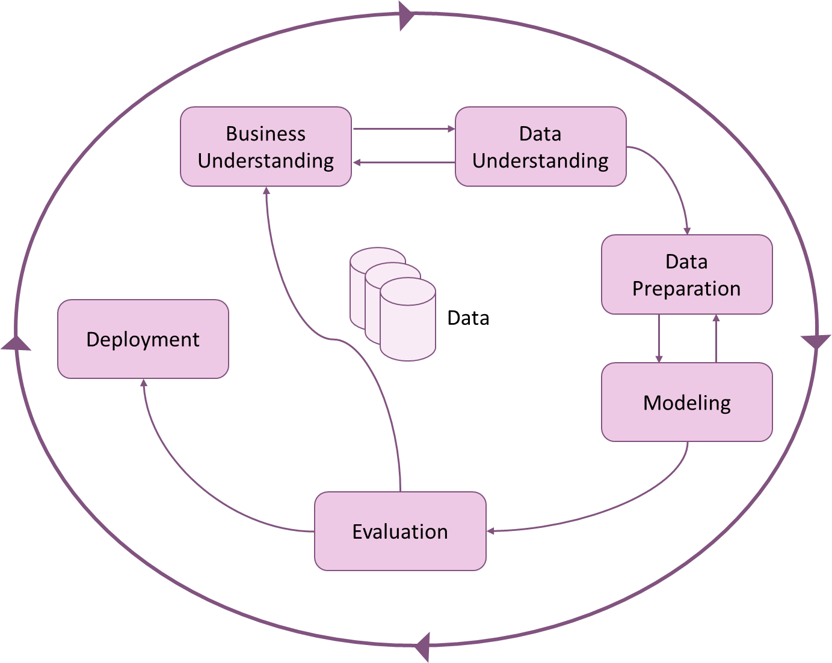
Approach-CRISP

Slide 12
Data
Understanding
& Preparation

Slide 13
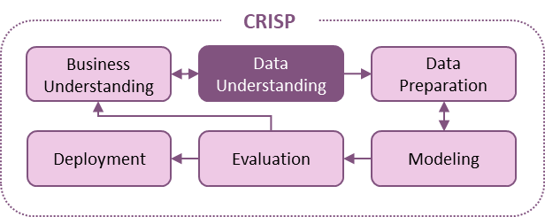
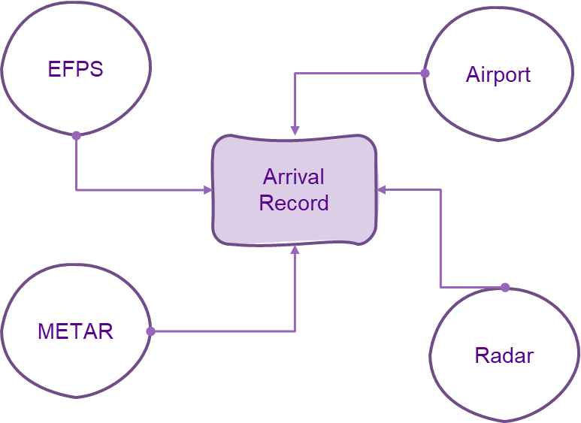
Data Sources
> 500k observations

Slide 14
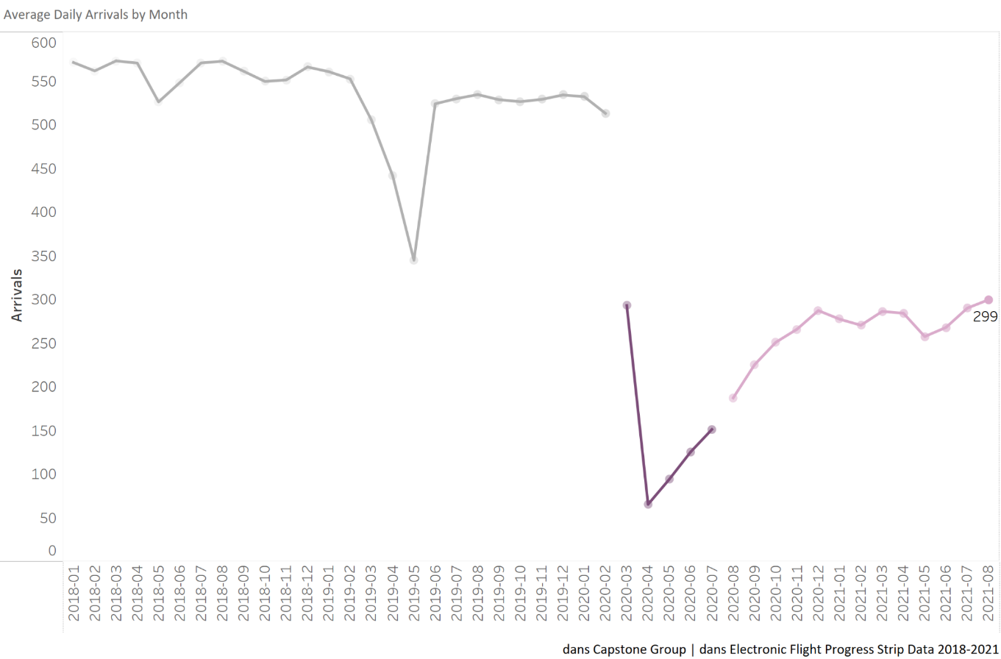
Arrivals by Month
Re-route
Covid Impact
Daily flight traffic is relatively stable
Covid-19 led the airport to operate well below capacity

Slide 15
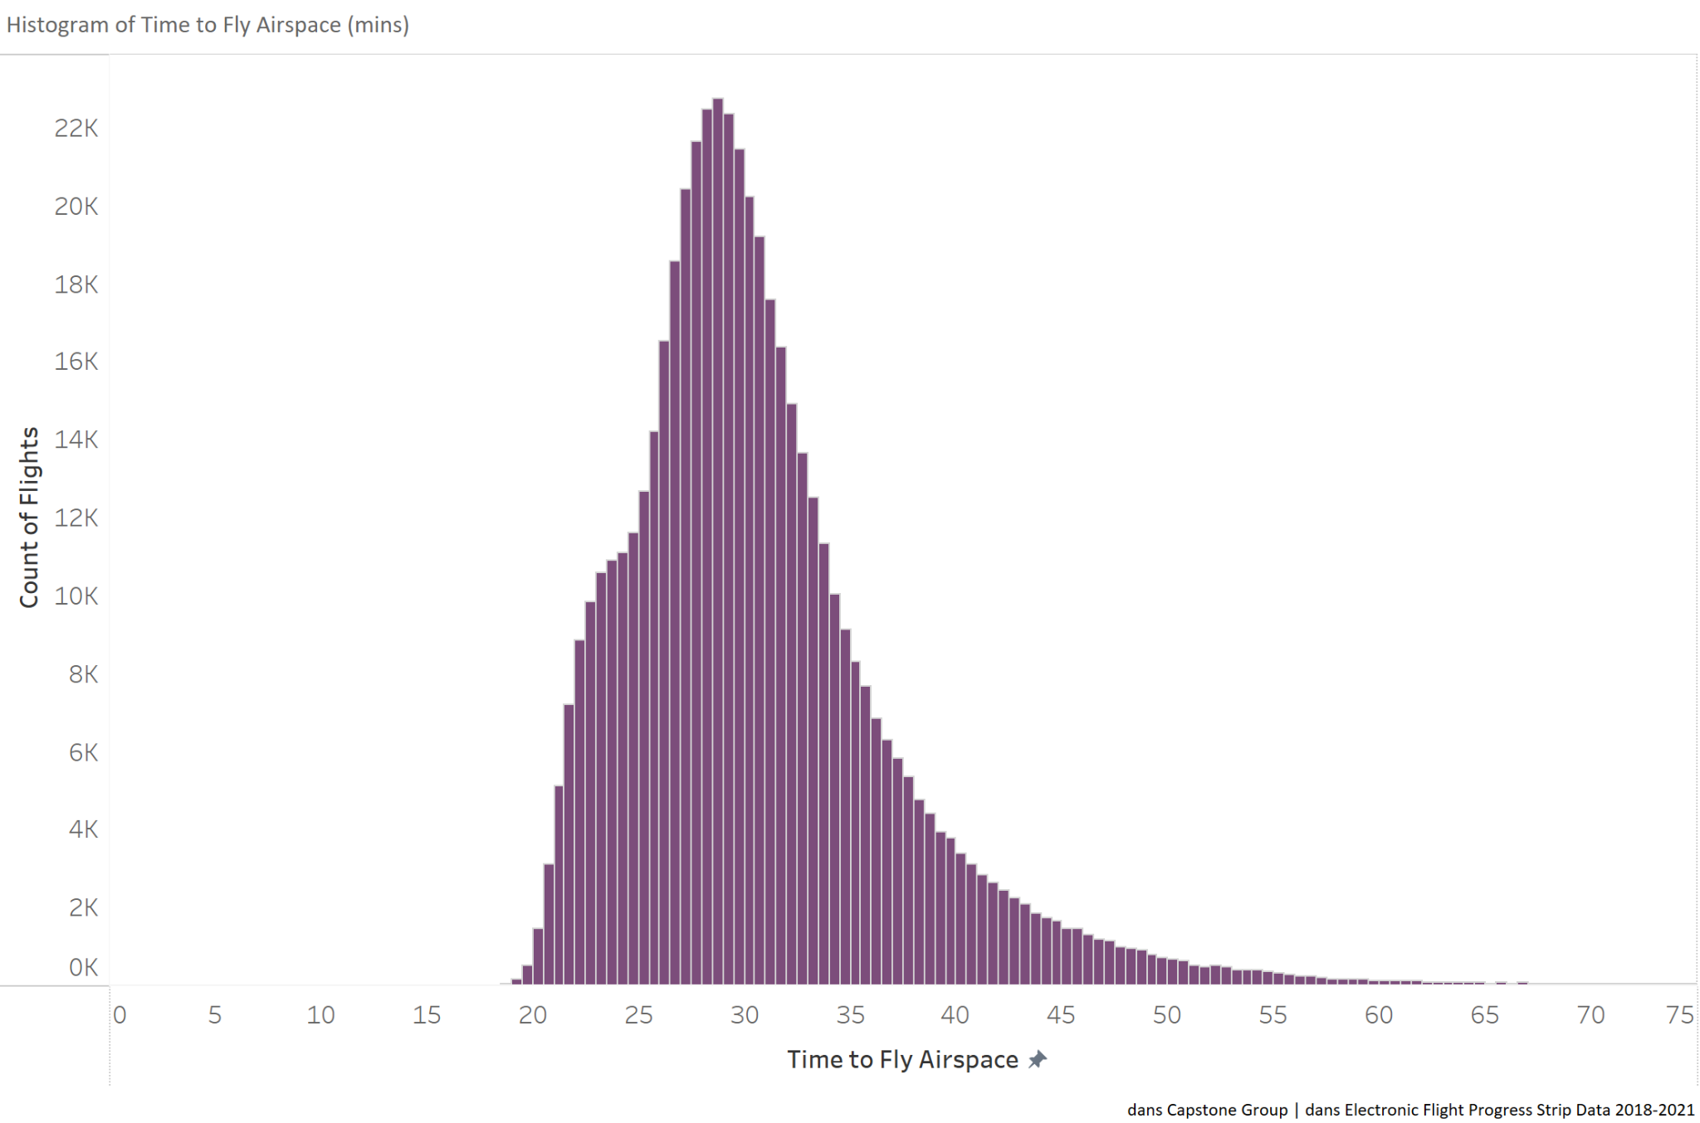
Time to Fly Airspace
Distribution
Mean time full dataset: 30.9 minutes
Under 5 min: impossible; data error
Over 60 minutes <0.5%: outlier
Mean time after adjustments: 30.7 minutes

Slide 16
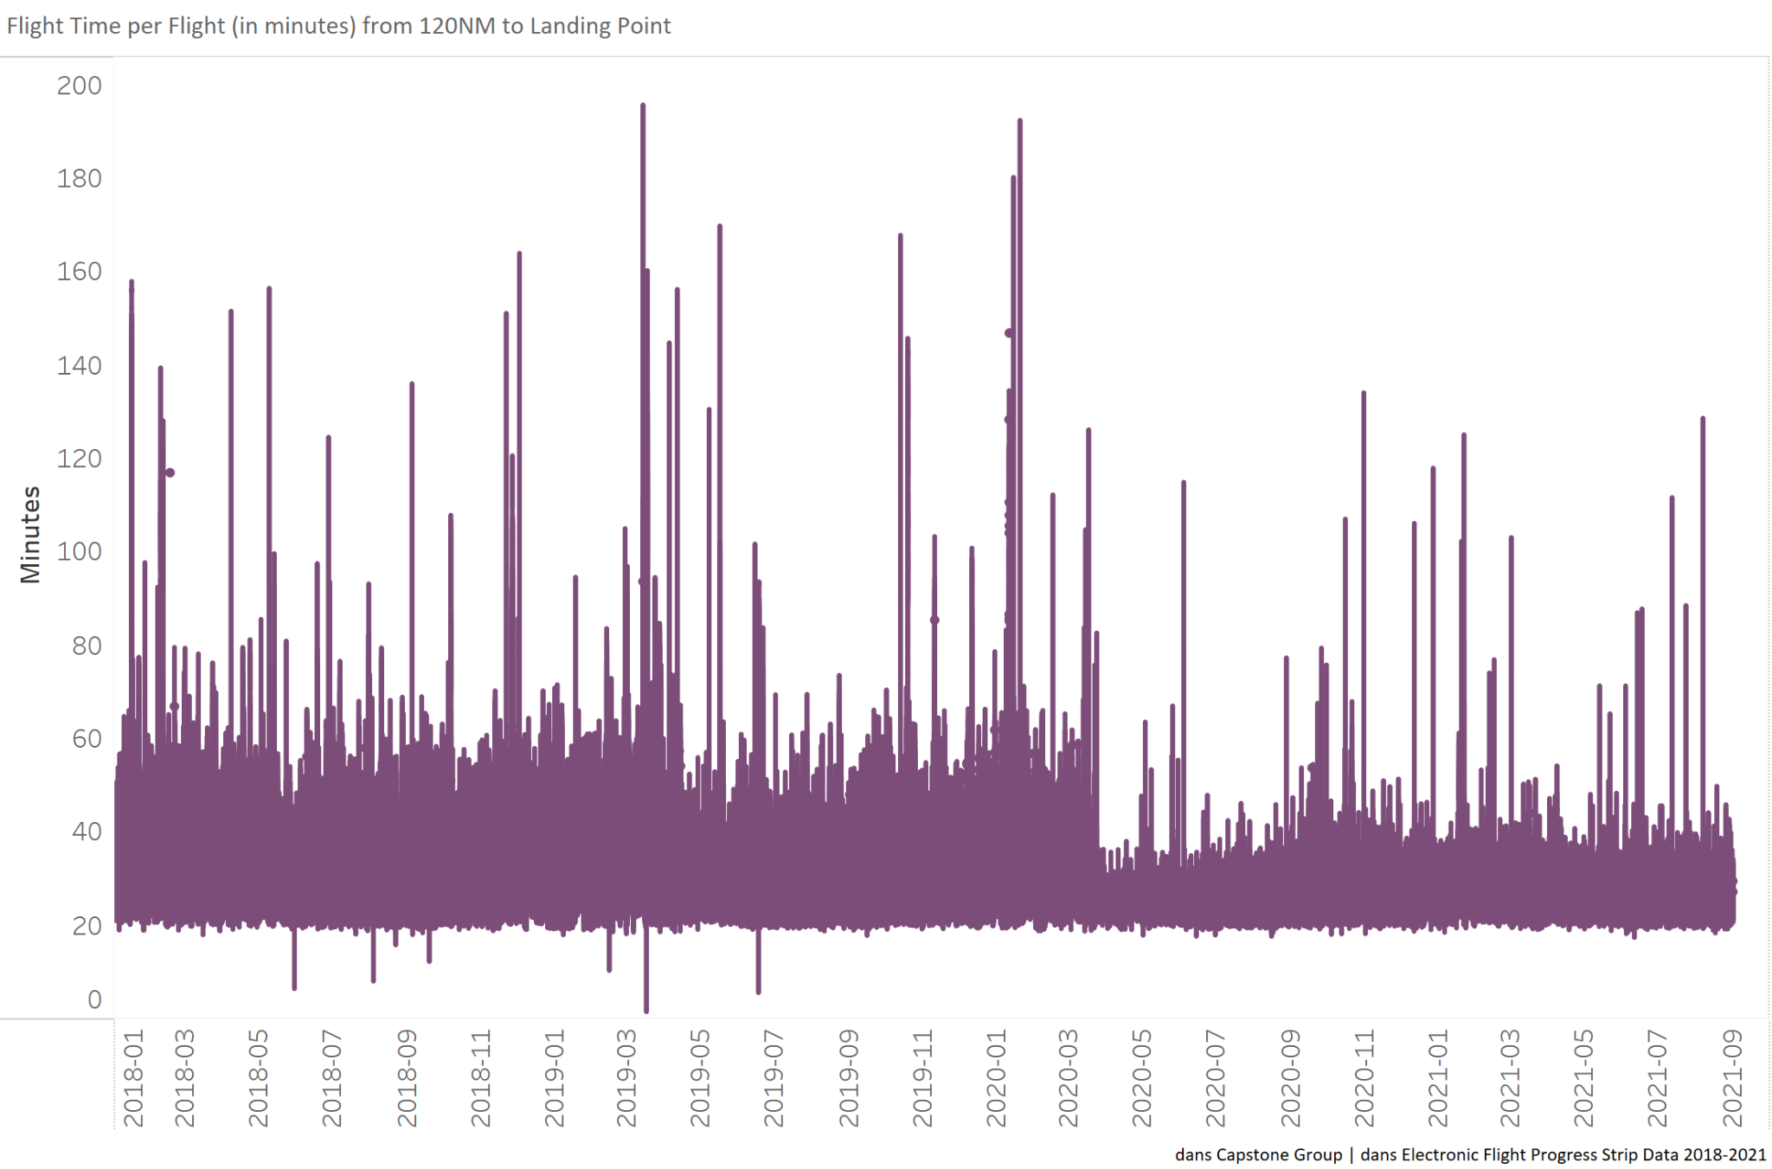
Time to Fly Airspace
Over Time
Preliminary observation:
Less airport traffic = faster arrival times

Slide 17
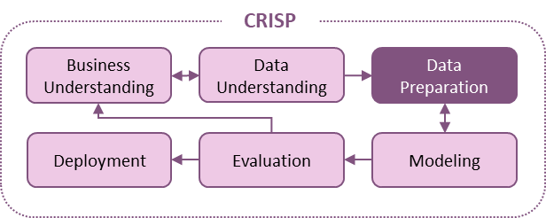
Feature Considerations
Weather Conditions
Flight Route
Aircraft and Airline
Seasonality
Congestion
Multicollinearity, Data Leakage

Slide 18
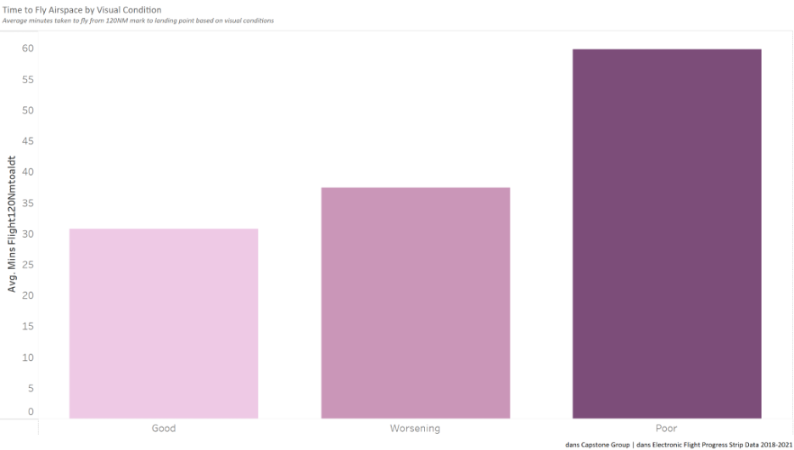
Weather Conditions
Visibility + Wind
As expected, flight times are faster in better visual conditions
Runway direction = proxy for wind direction

Slide 19
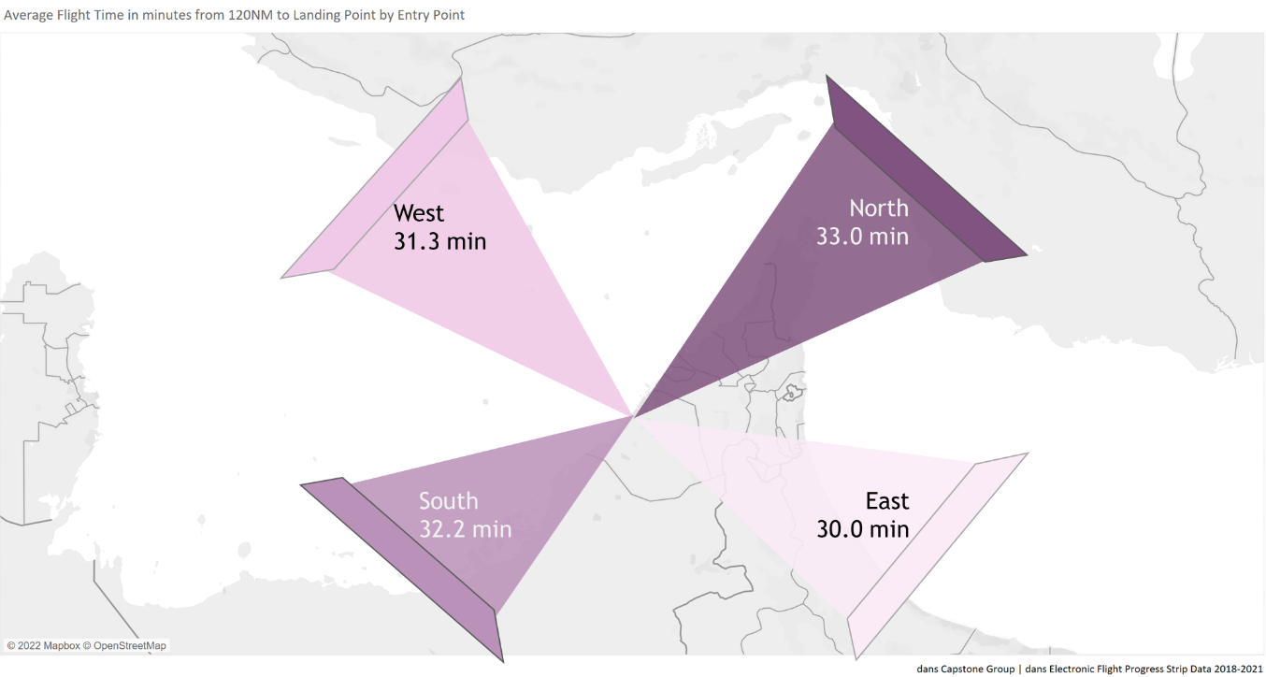
Flight Route
Direction from which the aircraft approaches the airport matters

Slide 20
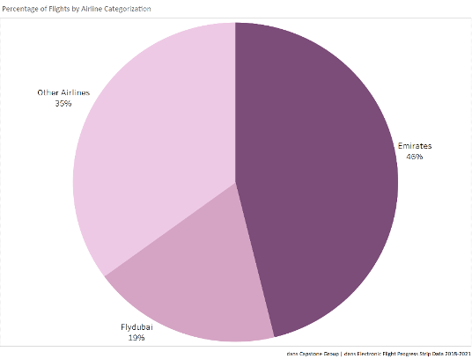
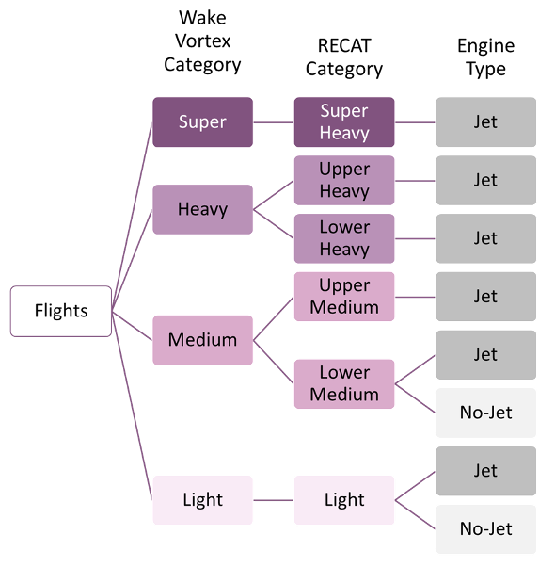
Aircraft & Airlines
Other airlines
Other airlines
Other AIrlines
35%
Emirates
46%
FlyDubai
19%

Slide 21
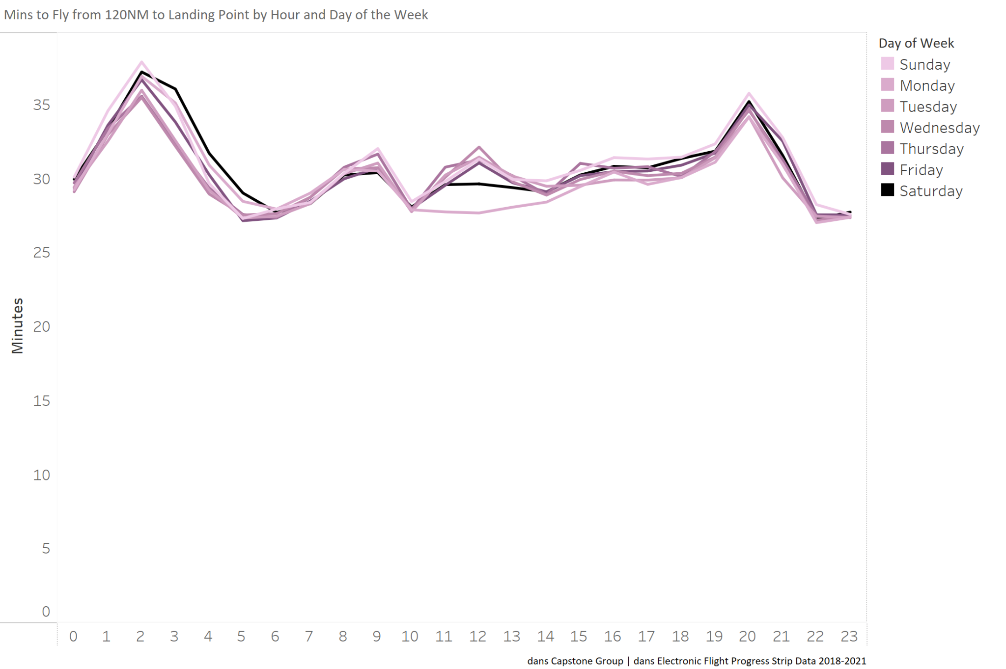
Timing
Strong daily seasonality
Consistent by day of the week

Slide 22
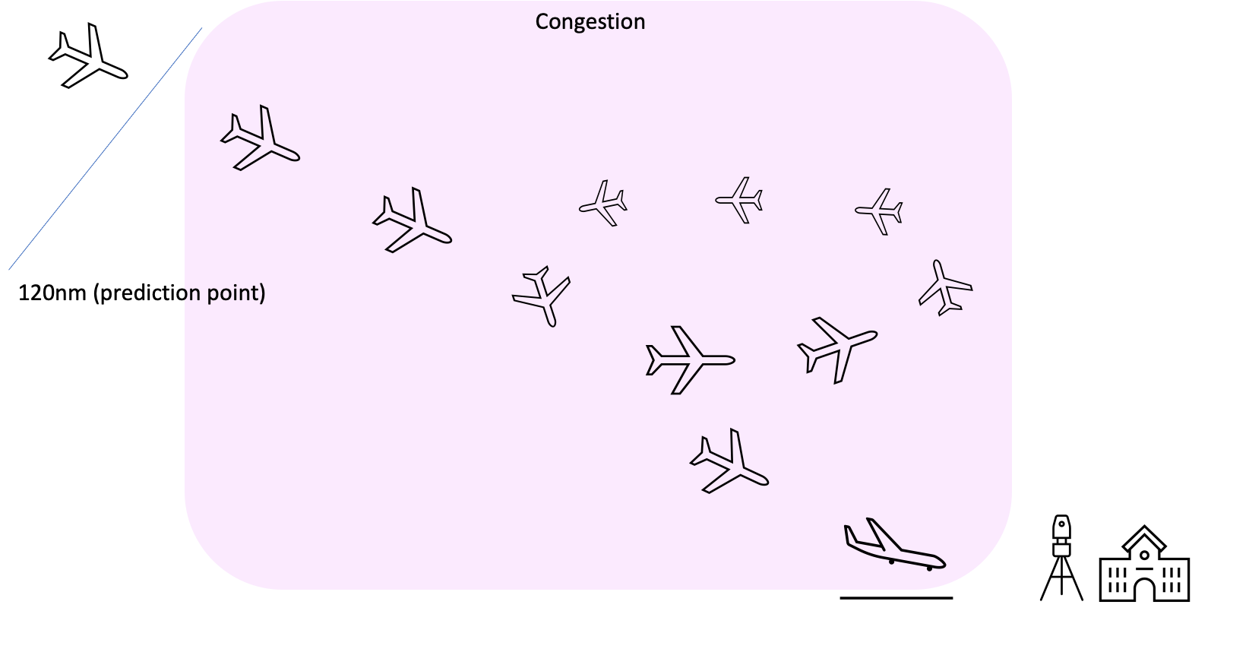
Congestion

Slide 23
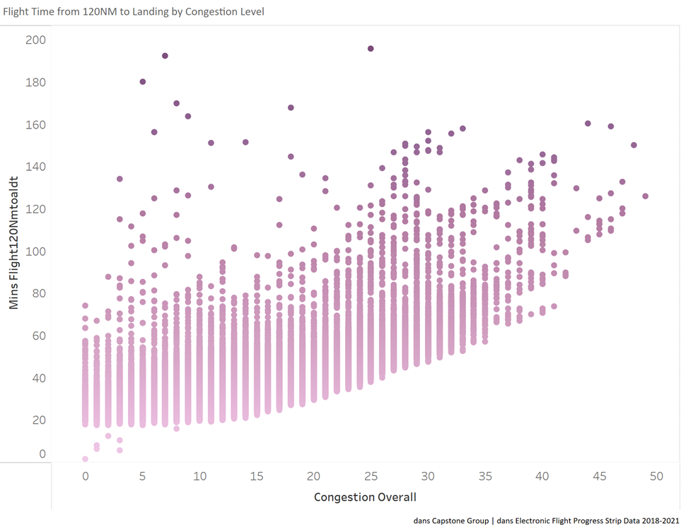
Congestion
Increased congestion leads to increased flight times
Effect increases with >10 flights in the air

Slide 24
Lag Congestion
Lag Predictor | Correlation | RMSE | % in Target
0 min | 0.691 | 5.1 | 52.1
10 min | 0.711 | 5.0 | 53.7
20 min | 0.702 | 5.0 | 52.9
30 min | 0.696 | 5.1 | 52.4
40 min | 0.695 | 5.1 | 52.3
All | 0.712 | 5.0 | 53.8

Slide 25
Modeling
&
Evaluation

Slide 26
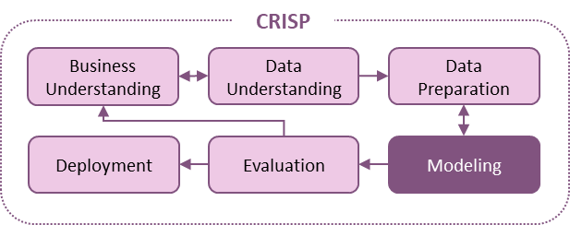
Options for Prediction
Baseline (Simple Average)
Decision Tree
Random Forest
XGBoost
Complexity
Notes:
Discuss/display model types being investigated/coded

Slide 27
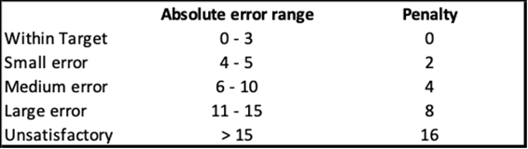
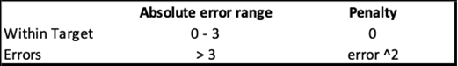
Evaluation Metrics
Standard
Custom Loss
RMSE
MAE
MAPE
Custom
Quadratic Loss
Custom Loss
Quadratic Loss
% in Target
Notes:
Discuss/display model types being investigated/coded

Slide 28
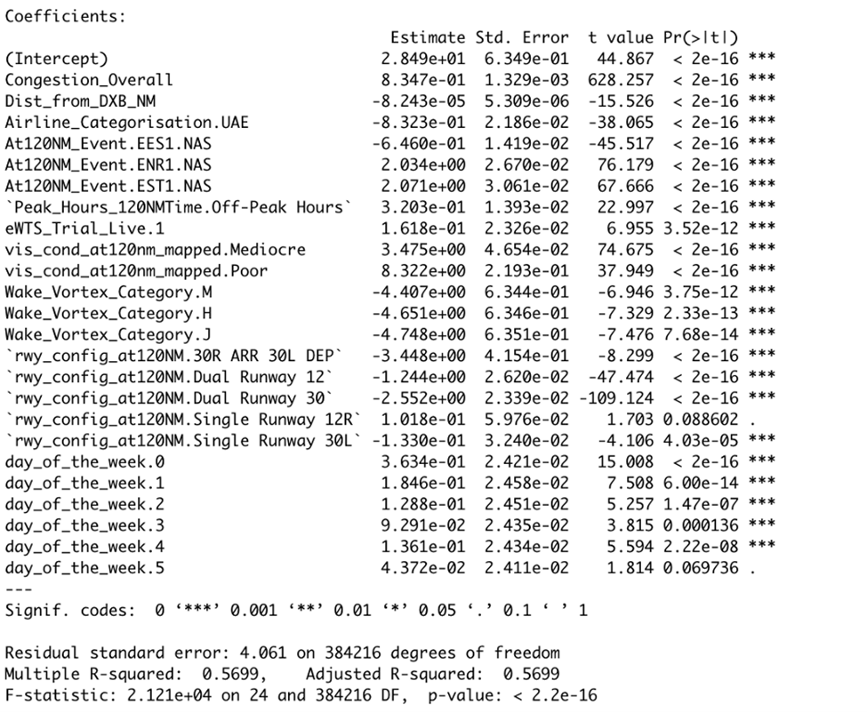
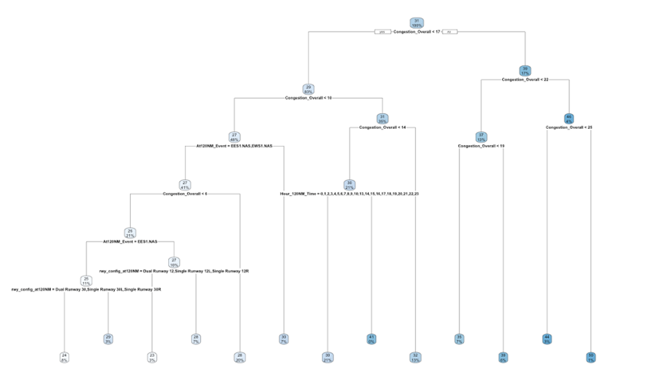
Variable Importance
Regression
Decision Tree
Notes:
Discuss/display model types being investigated/coded

Slide 29
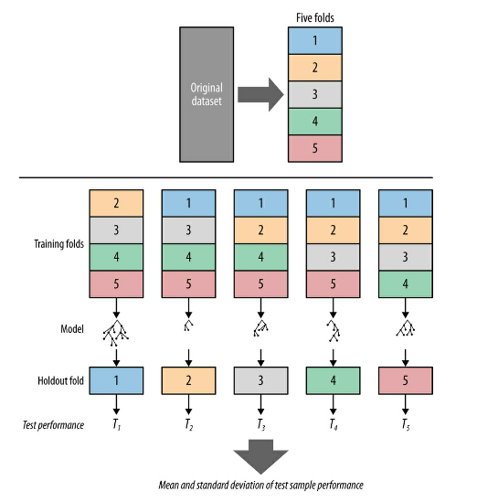
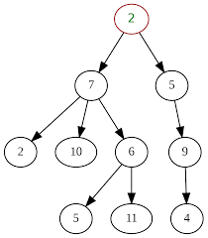

Hyperparameter Tuning
5-fold CV
Tree Depth
Learning Rate
Notes:
Foster’s book page 128
wikipedia
https://www.jeremyjordan.me/nn-learning-rate/

Slide 30
Covid Robustness
Full dataset
Pre-Covid
Performance Metric | Pre-Covid (Jan 2018 - Jan 2020) | Full Dataset (Jan 2018 - Aug 2021)
Custom Loss | 0.7 | 0.6
% in Target | 75.4% | 78.3%
Arrival Times over Time

Slide 31
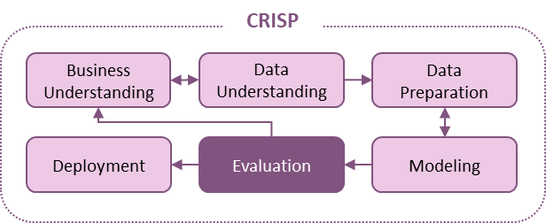
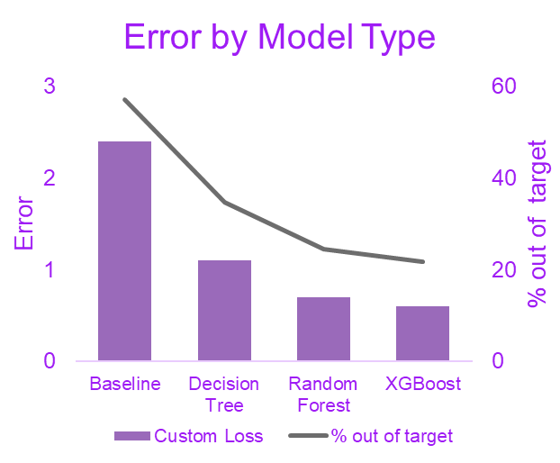
Model Performance
Error by Model Type
Model | MAE | MAPE | RMSE
Baseline (mean) | 4.7 | 15.1 | 6.2
Decision Tree | 3 | 9.7 | 3.8
Random Forest | 2.2 | 7.1 | 3.0
XGBoost | 2.0 | 6.6 | 2.8
Model | Custom Loss | Quad. Loss | % In Target
Baseline (mean) | 2.4 | 18 | 42.9
Decision Tree | 1.1 | 4.7 | 65.2
Random Forest | 0.7 | 2.3 | 75.4
XGBoost | 0.6 | 1.9 | 78.3
Notes:
Multi-collinearity issues, informational vs informative variables. New congestion variables

Slide 32
Model Performance
Error by Model Type
Model | MAE | MAPE | RMSE
Baseline (mean) | 4.7 | 15.1 | 6.2
Decision Tree | 3 | 9.7 | 3.8
Random Forest | 2.2 | 7.1 | 3.0
XGBoost | 2.0 | 6.6 | 2.8
Model | Custom Loss | Quad. Loss | % In Target
Baseline (mean) | 2.4 | 18 | 42.9
Decision Tree | 1.1 | 4.7 | 65.2
Random Forest | 0.7 | 2.3 | 75.4
XGBoost | 0.6 | 1.9 | 78.3
Notes:
Multi-collinearity issues, informational vs informative variables. New congestion variables

Slide 33
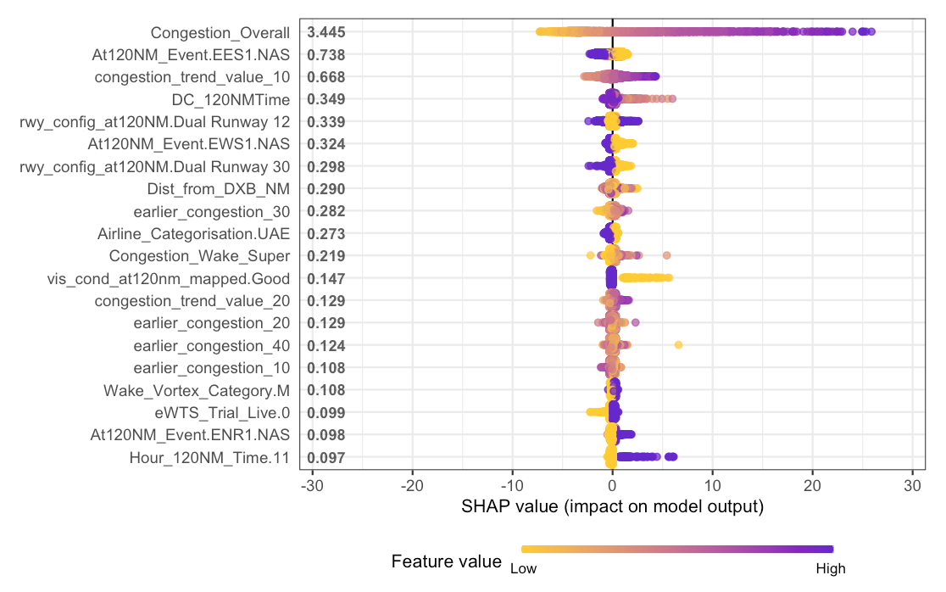
SHAP Analysis
Overall Congestion is 4.5x more important than any other variable
Approaching from the North leads to longer arrival times
Congestion is relevant at all lagged periods, as a trend, and overall
Notes:
Contribution of each variable to explain its impact on the model prediction

Slide 34
Deployment
&
Impact

Slide 35
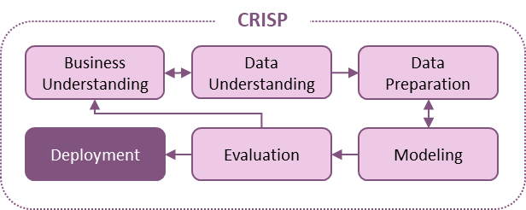
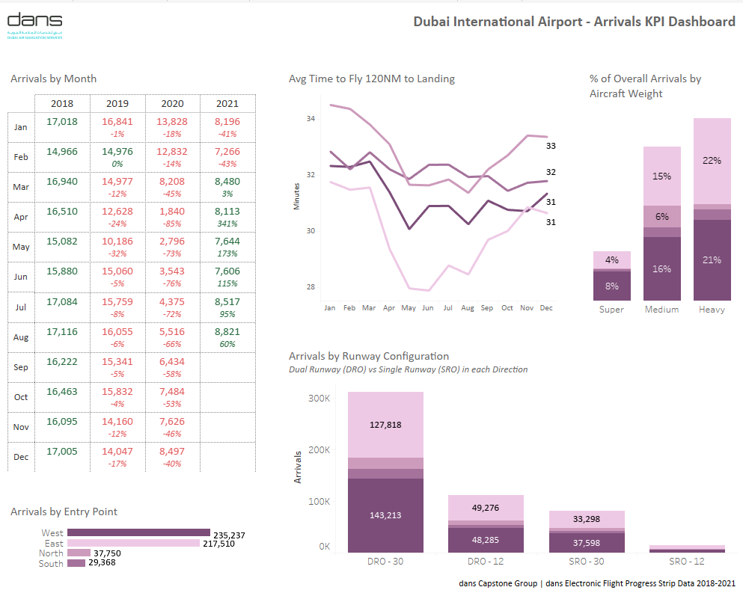
Dashboard
Notes:
Insert picture or video capture of interactive dashboard to monitor performance

Slide 36
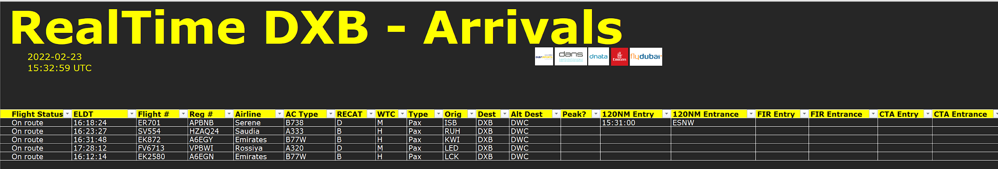
Deployment
Notes:
Insert images of Real-Time DXB proposed state

Slide 37
Impact of the model
Faster and more accurate predictions
Accuracy: 34% in target before our model to 78% in target with our model
Timing: Predictions can be made 15 minutes earlier
Leading to
Better ground crew resource management
More efficient and safe airspace management
Enhanced customer experience
Increased throughput capacity ultimately resulting in increased profits
Notes:
The larger prediction window provided by wheels down will lead to better ground crew resource management, and more efficient and safe airspace management by Air traffic control an air navigation service providers,, reduce at gate wait times, improve collaboration between teams, more efficient personnel resource management. leading to an enhanced passenger journey and increased throughput capacity ultimately resulting in increased profits.

Slide 38
Q & A

Slide 39
Appendix

Slide 40
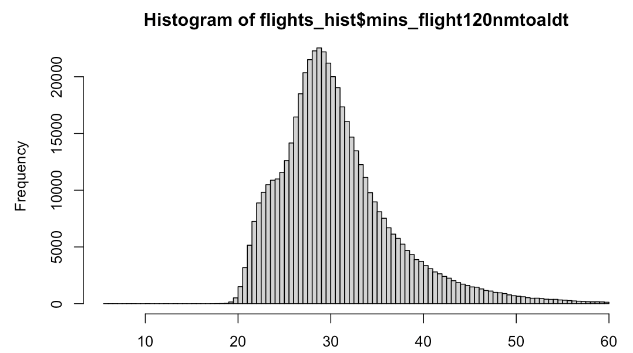
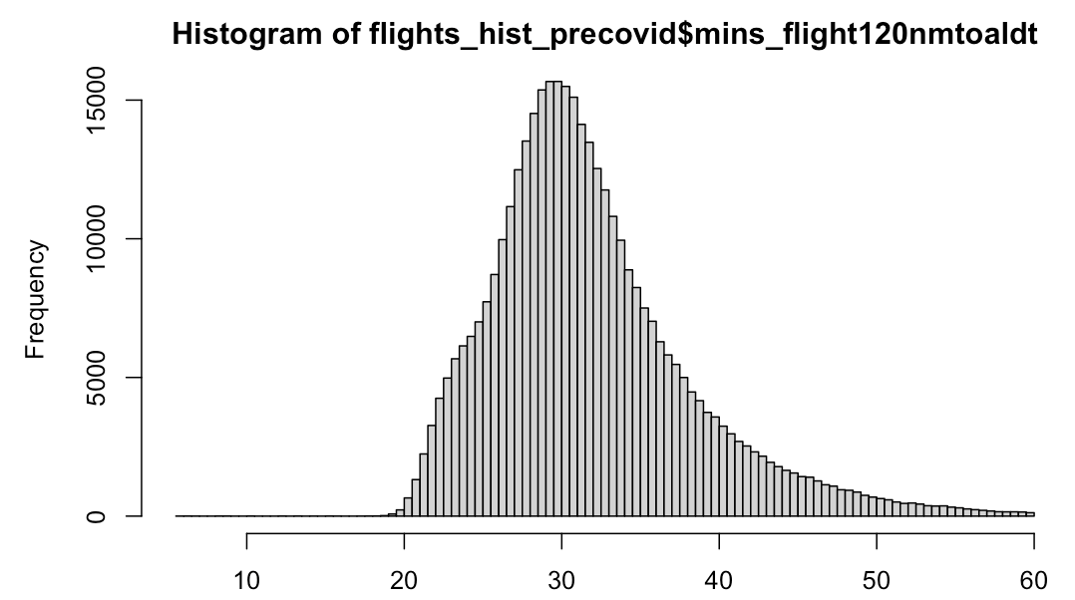
Effect of Covid on Distribution
Mean = 30.6 (excl. outliers)
Mean pre-covid = 31.8 (excl. outliers)

Slide 41
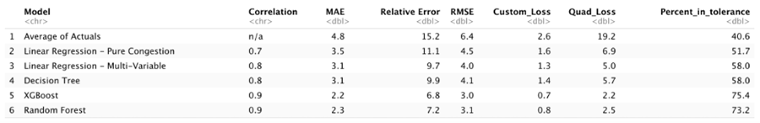
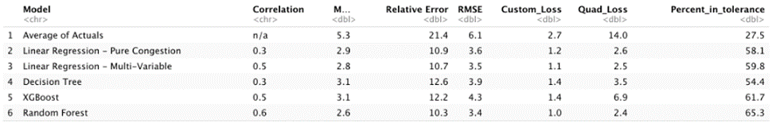
Pre-Covid Testing
Pre-Covid Randomized Training and Testing: From January 1, 2018 - January 31, 2021
Pre-Covid Timed Training and Testing: Train January 1, 2018 through January 31, 2020, Test June 1, 2021 - August 31, 2021

Slide 42
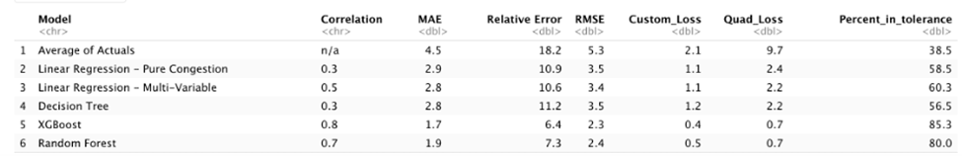
Time Based Training & Testing
Full Period Time Training and Testing: Train January 1, 2018 through May 31, 2021, Test June 1, 2021 - August 31, 2021

Slide 43
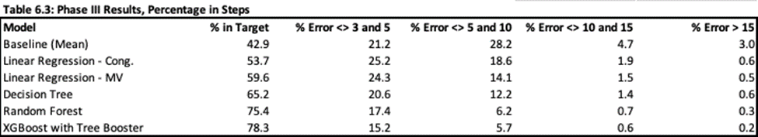
Percentage in Steps

